Slide 1
Simple logic gates

Slide 2
So we've seen that binary can be used to store numbers, text, and colour codes, what we can use binary for much more than storing values;
Binary also forms the basis of all the logic functionality that occurs within computers. We do this through what are commonly known as logic gates.
All gates can be simplified down into the three of AND, OR and NOT but there are six gates we will learn in this course:
AND NAND OR NOR NOT XOR
The following video provides a great introduction into how you can easily create your own logic gates and how they work. https://www.youtube.com/watch?v=fB85NrUBBhQ
https://logic.ly/demo/samples

Slide 3
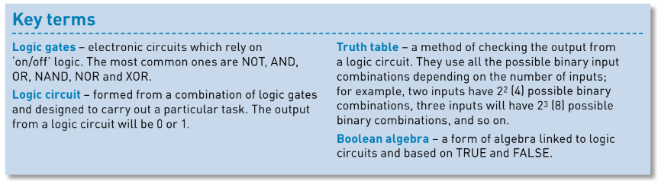
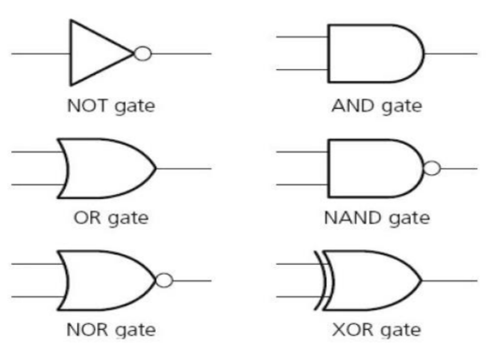

Slide 4
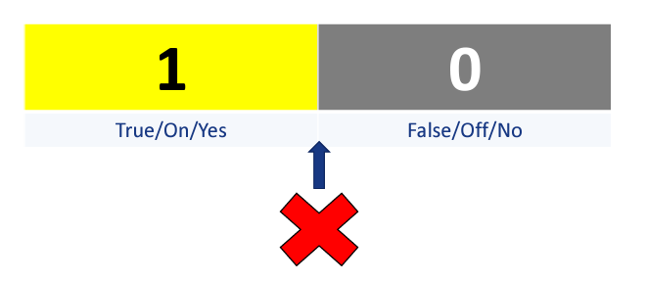
Topic 2.1.11 Define the Boolean operators: AND, OR, NOT, NAND, NOR and XOR
What is logic?
• It's how a machine will solve problems.
• Machines (at basic level) do not understand semantics like humans – no grey areas.

Slide 5


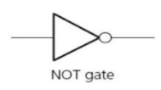
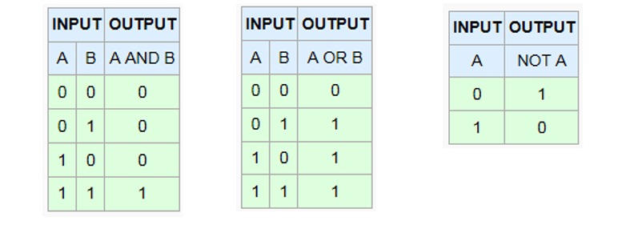
The output is true when A is true or B is true, or both are true.
The output is true when the input is false (unary operator).
The output is true when A and B is true.

Slide 6
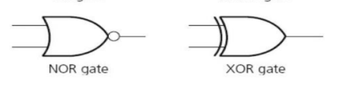

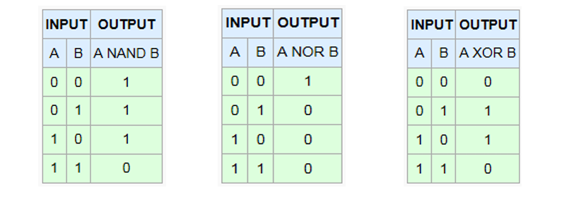
The output is true when A is false and B is false
The output is true when A is true or B is true (Note the “or both” condition does not apply).
The output is true when A is false or B is false, or both are false.

Slide 7
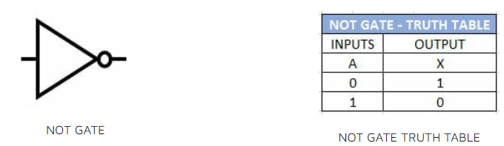

THE NOT GATE
The NOT gate is the only gate with just one input. The NOT gate simply reverses the input, if the input is ON then the OUTPUT is OFF, if the input is OFF then the output is on.

Slide 8
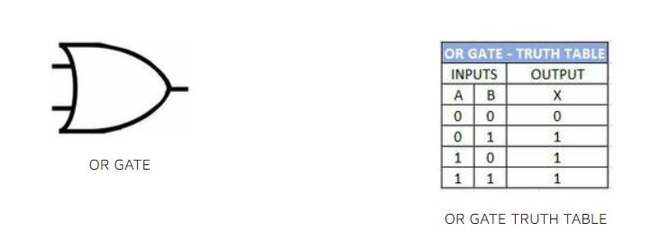
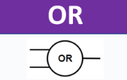
THE OR GATE
The OR gate will give an output value of ON if any of the inputs are ON.
The OR gate can be viewed as the mathematical equivalent of addition.
A + 0 = A
A + A = A
0 + 0 = 0
A + Ā = 1

Slide 9
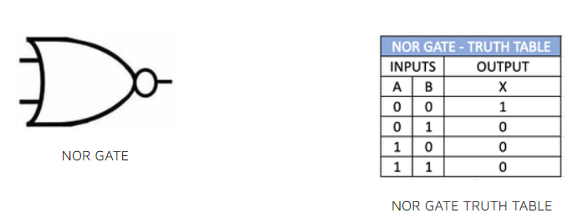
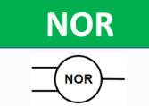
THE NOR GATE
The NOR Gate or NOT OR Gate will have an output if none of the inputs are 1. The NOR gate has a circle on the output to define the NOT part of the gate. You can see this as the opposite of an OR gate.

Slide 10
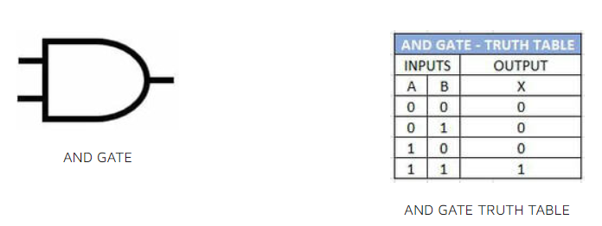
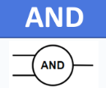
THE AND GATE
The AND gate will only give an output when both inputs are ON, in other works input one AND input two need to be ON to make the output ON.
The AND gate can be viewed are the mathematical equivalent to multiplication.
A x 0 = 0
A x 1 = A
​A x A = A
A x Ā = 0

Slide 11
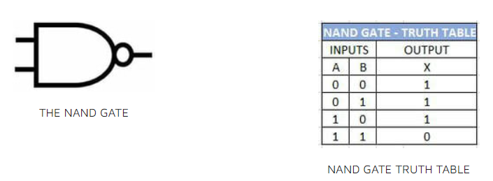
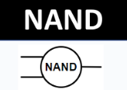
THE NAND GATE
The NAND Gate or NOT AND Gate will have an output when the two inputs are not ON. Or with a three input NAND gate when all 3 inputs are not ON.

Slide 12
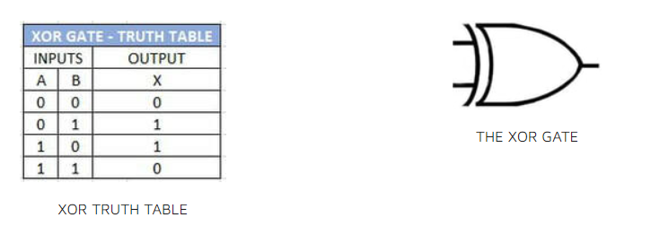
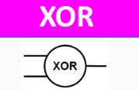
THE XOR GATE
The XOR gate or eXclusive OR will only produce an output it the two inputs are different values.

Slide 13
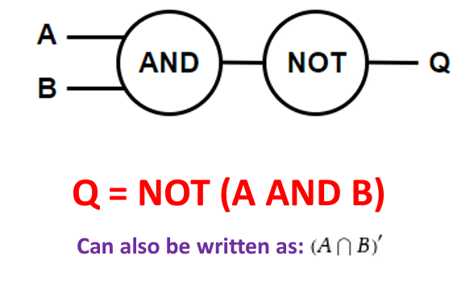
Combining gates (example 1)

Slide 14
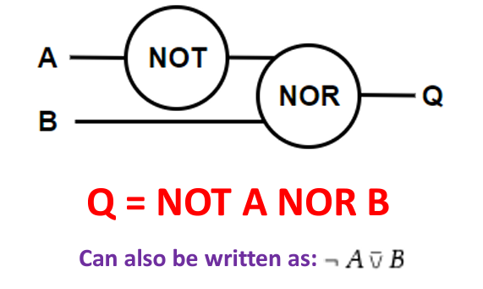
Combining gates (example 2)

Slide 15
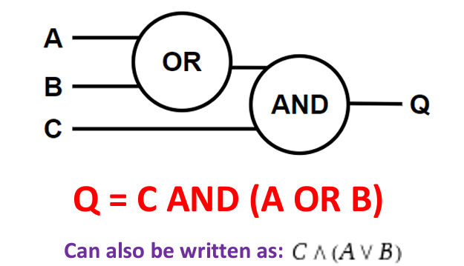
Combining gates (example 3)

Slide 16
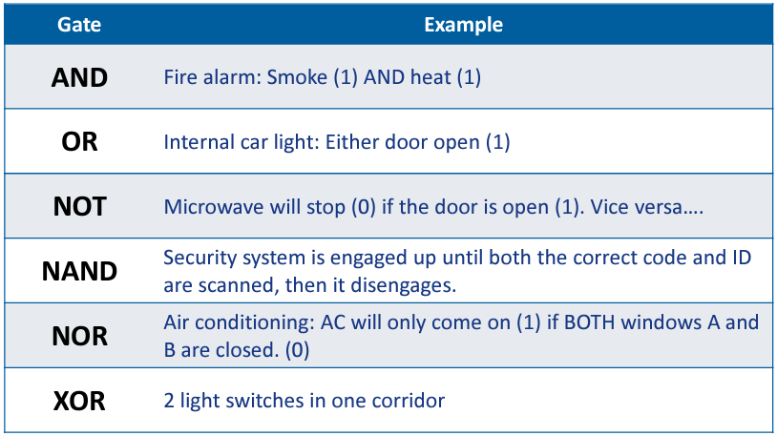
Possible real-world applications

Slide 17

Like PEMDAS in mathematics, an order of precedence exists for equations involving gates. The order of precedence is:
1. NOT
2. AND (NAND)
3. OR (NOR, XOR)

Slide 18
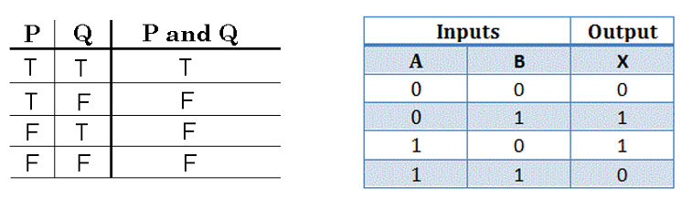
Construct truth tables
Truth table = All possible combinations
It is a mathematical table that shows all possible outcomes that would occur from all possible scenarios that are considered factual (i.e. is true), hence the name.
It contains values like T/F or TRUE/FALSE or 1/0…

Slide 19
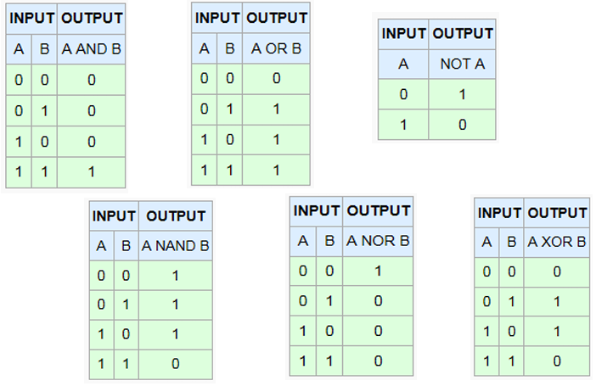
Know the 6 basic tables

Slide 20
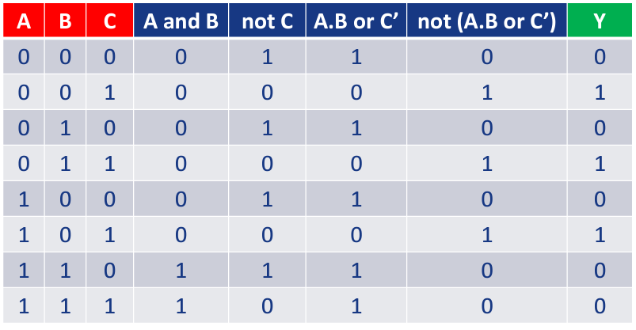

Slide 21
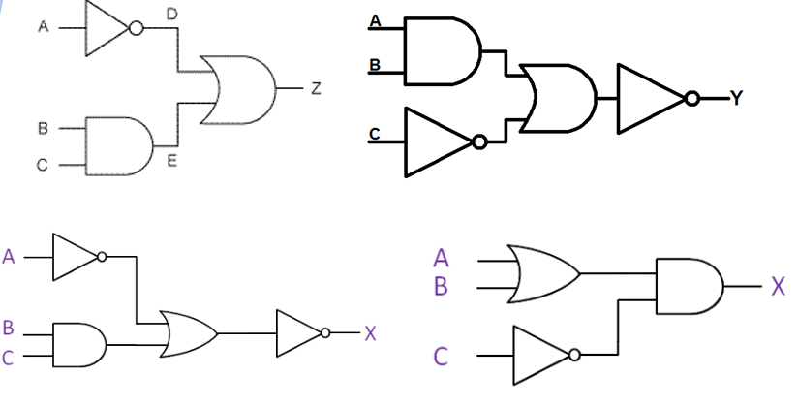
Practice on these*
*Look up the symbols if you need to

Slide 22
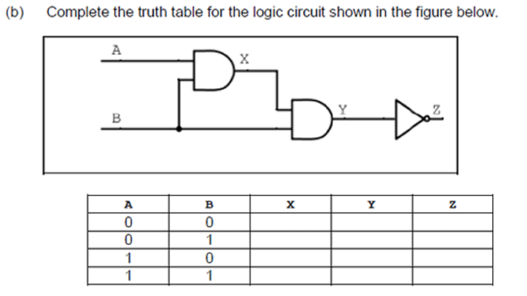
Very basic exam type question

Slide 23
Video link: Truth Tables
https://youtu.be/N5VBSWRRdUw
Wolfram Alpha Boolean Algebra Calculator

Slide 24
Past exam question
Turn the following logic statement into a logic diagram:
Y = NOT (A AND B) OR C

Slide 25
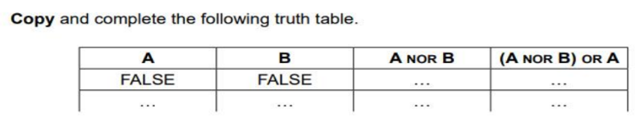

Slide 26


Slide 27


Slide 28
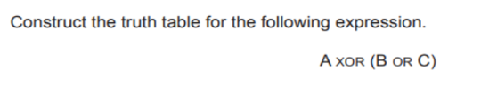

Slide 29
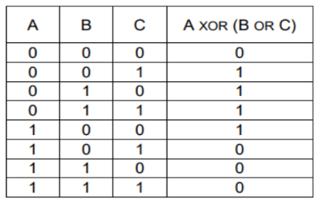

Slide 30
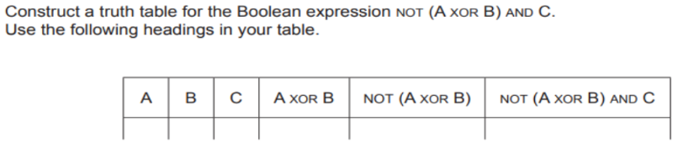

Slide 31
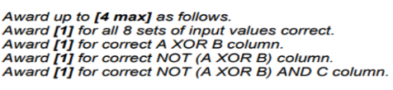
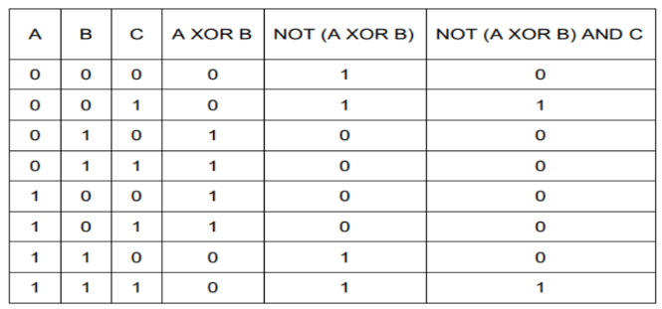

Slide 32
Resources
https://logic.ly/demo/samples
Data representation
Logic gates | AP CSP (article) | Khan Academy

